Slide 1
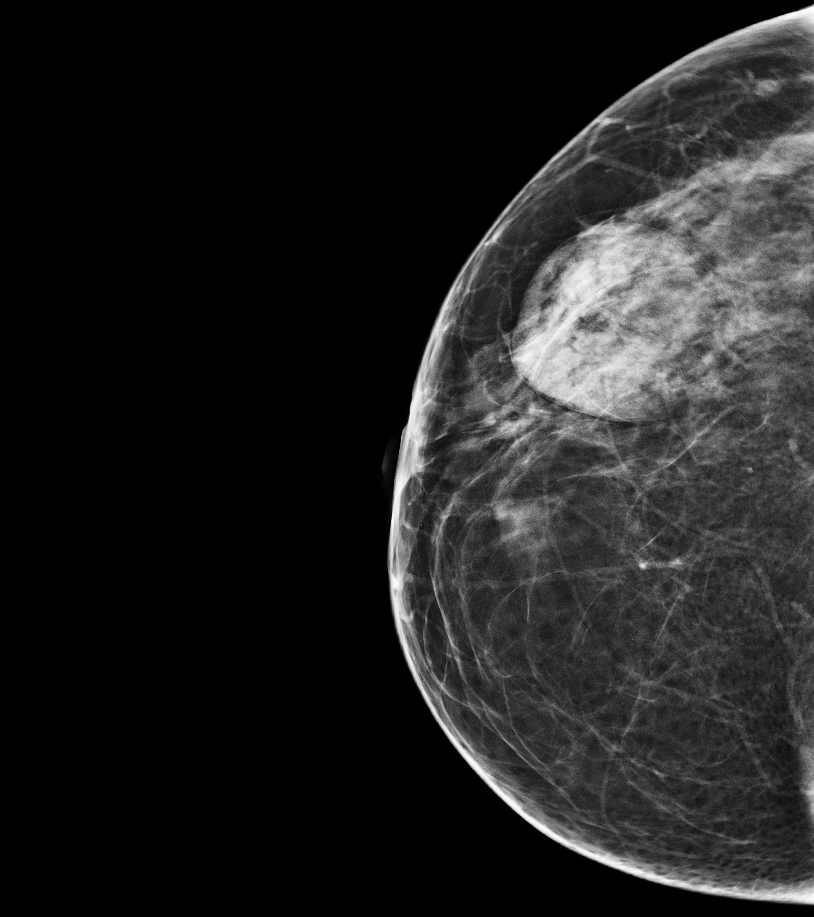
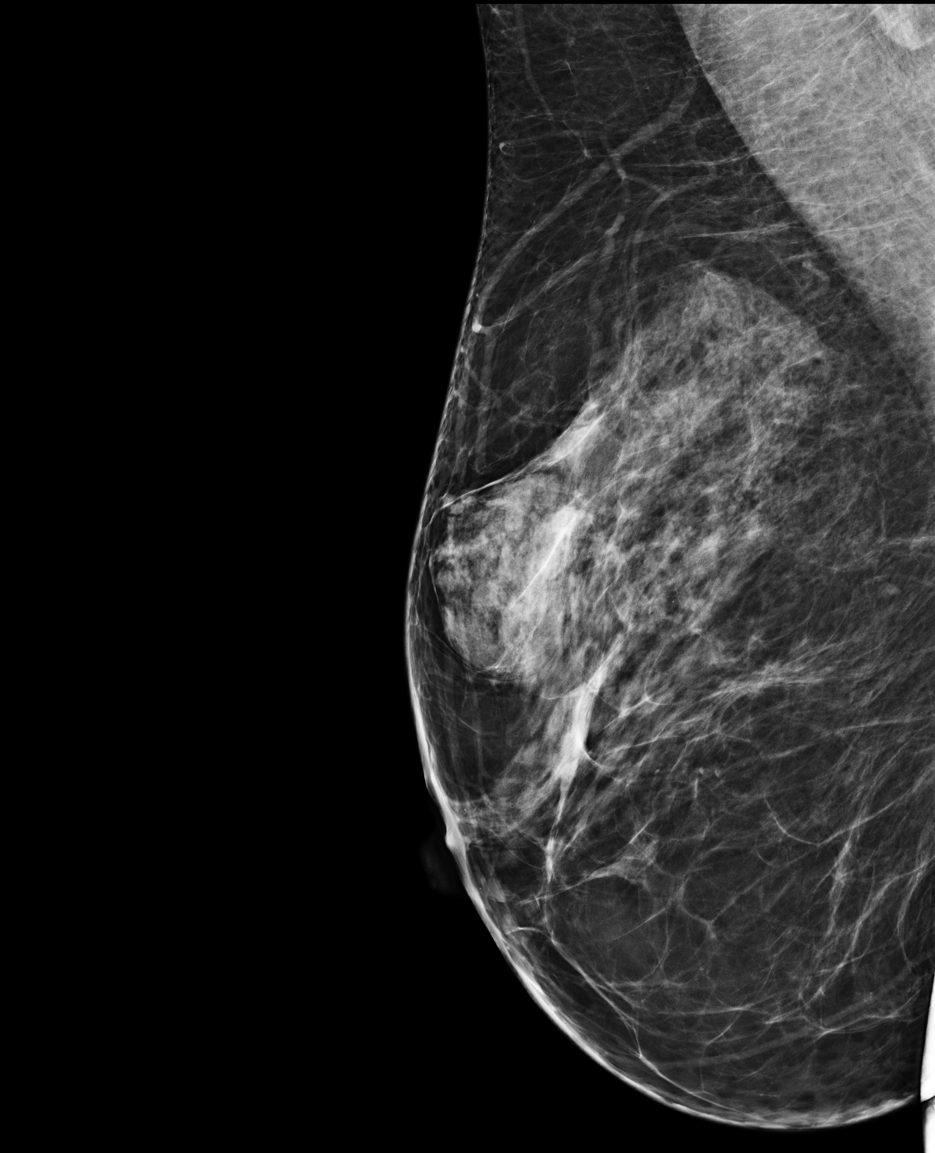
Breast: Case 1
Prompt:
May you please write a report for the images?
GPT-4V:
Study Type: Mammography
Findings:
The images provided appear to be mediolateral oblique (MLO) and craniocaudal (CC) views of a mammogram.
Breast Tissue Composition: The breast tissue demonstrates heterogeneously dense composition. This can sometimes obscure the visibility of small masses or other findings.
Masses: A notable area of increased density can be observed, suggestive of a potential mass or lesion. Its borders and characteristics are not clearly delineated from the provided images.
Calcifications: No specific microcalcifications or macrocalcifications are readily apparent in the images.
Other Findings: No other significant abnormalities such as skin thickening, nipple retraction, or lymphadenopathy are evident in the images provided.
Impression: There appears to be a potential area of concern related to a mass or lesion. Given the limited resolution and the fact that only two views are provided, a comprehensive assessment cannot be made. Correlation with prior mammograms, additional views, and possibly ultrasound or MRI may be beneficial for a more definitive evaluation.
Prompt:
What disease may be linked with the patient?
GPT-4V:
I'm not a medical professional, but the image appears to be a mammogram, which is a type of X-ray used primarily to check for breast cancer in women. If you or someone you know has concerns about any medical imaging, it's essential to consult with a radiologist or medical professional to get an accurate diagnosis.
Reference answer:
Modality: Mammography(First CC, Second MLO), Anatomy: Breast, Diagnosis: Breast hamartoma
Description:
There is a well-circumscribed mixed-density lesion located in the upper outer quadrant of the right breast (containing both fatty and glandular components), giving a "breast within breast" appearance.
No associated suspicious microcalcifications.
No abnormal skin thickening.
Non-specific right axillary LN with fatty density hilum.

